Slide 1


ARCH-FL TECHNOLOGIES
Privacy-Preserving Federated Learning
Presented by [Group 8]

Slide 2
Introduction to ARCH-FL
AI and Privacy in Healthcare

Slide 3

The Role of AI
Enhancing Diagnostics in Medical Imaging
AI significantly improves diagnostic accuracy in medical imaging, particularly through automated analysis of chest X-rays, facilitating early detection of thoracic diseases and streamlining the workflow for healthcare professionals.

Slide 4

Data Privacy Challenges
01
02
03
HIPAA mandates strict patient data confidentiality and security requirements.
GDPR enforces stringent regulations on personal data collection and processing.
Both regulations create barriers for data sharing and innovation.

Slide 5
Problem Statement
Clarifying Research Focus

Slide 6
Limitations of Current Systems
01
02
03
04
Centralized systems expose sensitive patient data to unauthorized access.
Non-private federated learning lacks robust privacy protections for participants.
Performance degrades under non-IID data due to increased variability.
Standardized frameworks for integrating differential privacy are currently absent.

Slide 7
Privacy Vulnerabilities & Performance Issues
01
02
03
04
Non-IID data increases susceptibility to privacy attacks and breaches.
Models trained on non-IID data often suffer from reduced accuracy.
Privacy-preserving techniques can lead to performance trade-offs in accuracy.
Centralized training exacerbates vulnerabilities in federated learning environments.

Slide 8
ARCH-FL Framework Overview
Integrating Differential Privacy with Federated Learning

Slide 9
ARCH-FL Overview
Open-Source Privacy Framework
ARCH-FL is a pioneering framework that integrates differential privacy with federated learning, specifically designed for chest X-ray classification, ensuring data privacy while enabling collaborative AI model training across healthcare institutions.

Slide 10
Key Features of ARCH-FL
Privacy-Preserving Framework Benefits
DP-SGD
Secure Aggregation
Privacy-Utility Trade-Offs
Differential Privacy Stochastic Gradient Descent (DP-SGD) enhances local training by introducing noise, ensuring models learn from data while maintaining user privacy and safeguarding sensitive medical information from potential breaches.
Secure aggregation methods ensure that model updates are combined without revealing individual data contributions, thus preserving privacy and enabling collaborative efforts among healthcare institutions without compromising sensitive patient information.
Evaluating privacy-utility trade-offs allows researchers to balance privacy guarantees with model performance, ensuring that federated learning achieves accurate predictions while still adhering to stringent privacy regulations such as HIPAA and GDPR.

Slide 11
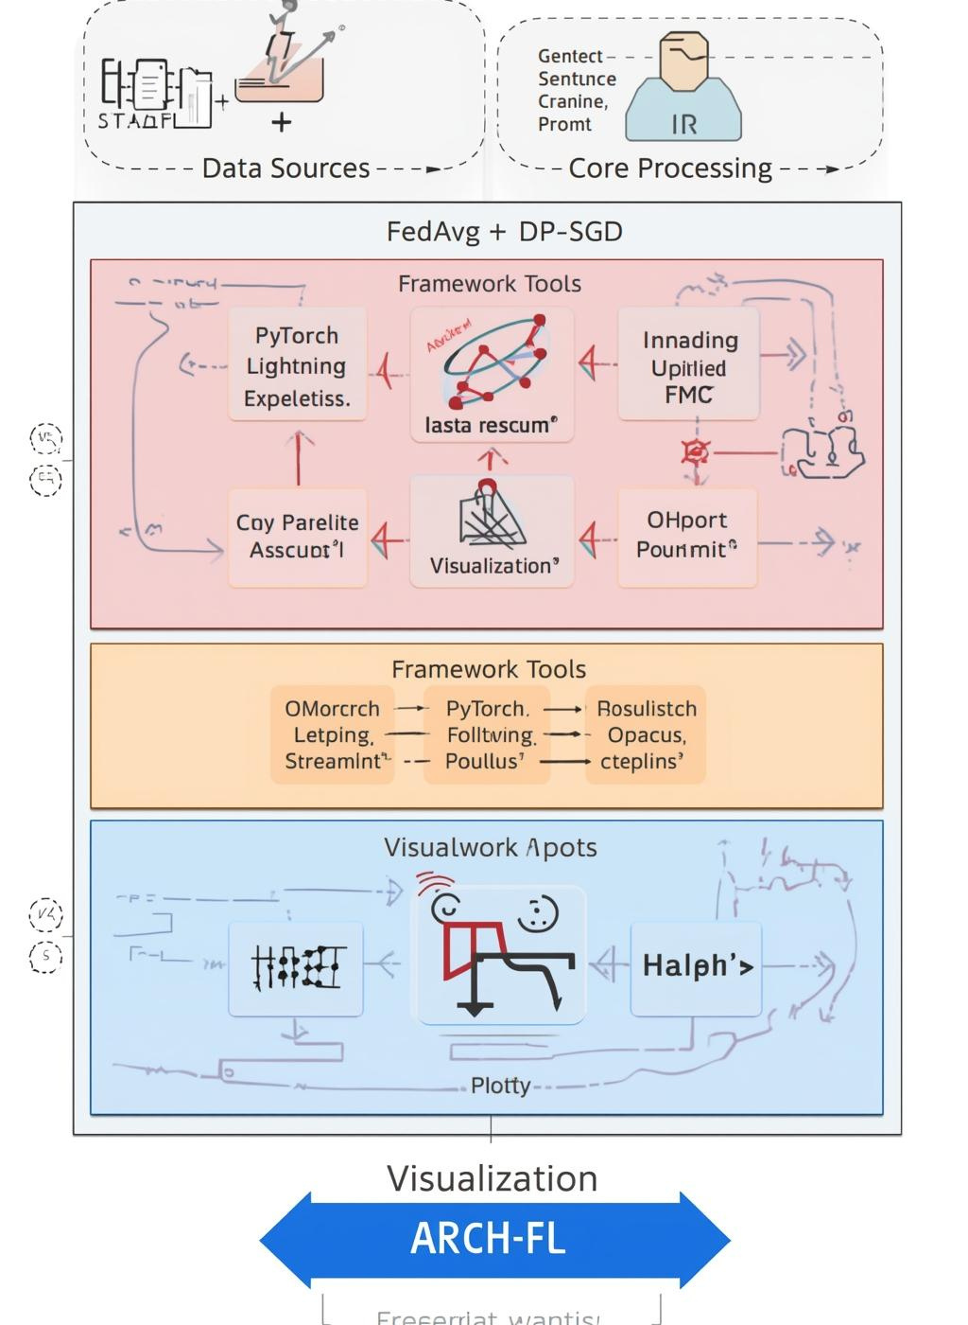
System Architecture of ARCH-FL
Overview of the Framework Components
The ARCH-FL framework integrates differential privacy with federated learning for chest X-ray classification, ensuring secure data handling. Its architecture supports seamless collaboration while maintaining privacy and enhancing diagnostic accuracy.

Slide 12
Research Methodology Overview
Phases and design elements

Slide 13
Agile-Experimental Methodology Phases
Key Steps for Success
The Agile-Experimental Development Methodology consists of iterative phases: design, development, experimentation, evaluation, and dissemination, ensuring a structured yet flexible approach for continuous improvement in research outcomes.

Slide 14
Data Partitioning Strategies
01
02
03
04
05
IID strategies ensure uniform data distribution across all clients.
Non-IID strategies introduce diversity in data distribution among clients.
Dirichlet partitioning simulates real-world data variability in healthcare.
Quantity-based skew reflects unequal data amounts among different clients.
Proper partitioning influences model performance and privacy preservation significantly.

Slide 15
Experimental Design Variables
01
02
03
04
Privacy budget (ε) determines the level of data privacy assurance.
Non-IID severity affects model performance and generalization capabilities significantly.
Client fraction influences the training efficiency and convergence speed.
Balancing these variables is crucial for effective federated learning outcomes.

Slide 16
Validation and Ethics
Ensuring Rigor and Impact

Slide 17
Validation Strategies in ARCH-FL
01
02
03
04
Technical validation involves rigorous unit and integration testing processes.
Empirical validation assesses performance through baseline and ablation studies.
Peer validation engages academic review to ensure research quality and credibility.
Continuous feedback mechanisms promote iterative improvement and stakeholder engagement.

Slide 18
Ethical Considerations in ARCH-FL
01
02
03
04
GDPR and HIPAA compliance ensures patient data protection and privacy.
Transparency via open-source promotes trust and allows community collaboration.
Formal DP guarantees safeguard against potential data privacy breaches.
Ethical practices foster responsible AI use in healthcare diagnostics.

Slide 19

Thankyou!

